Slide 1


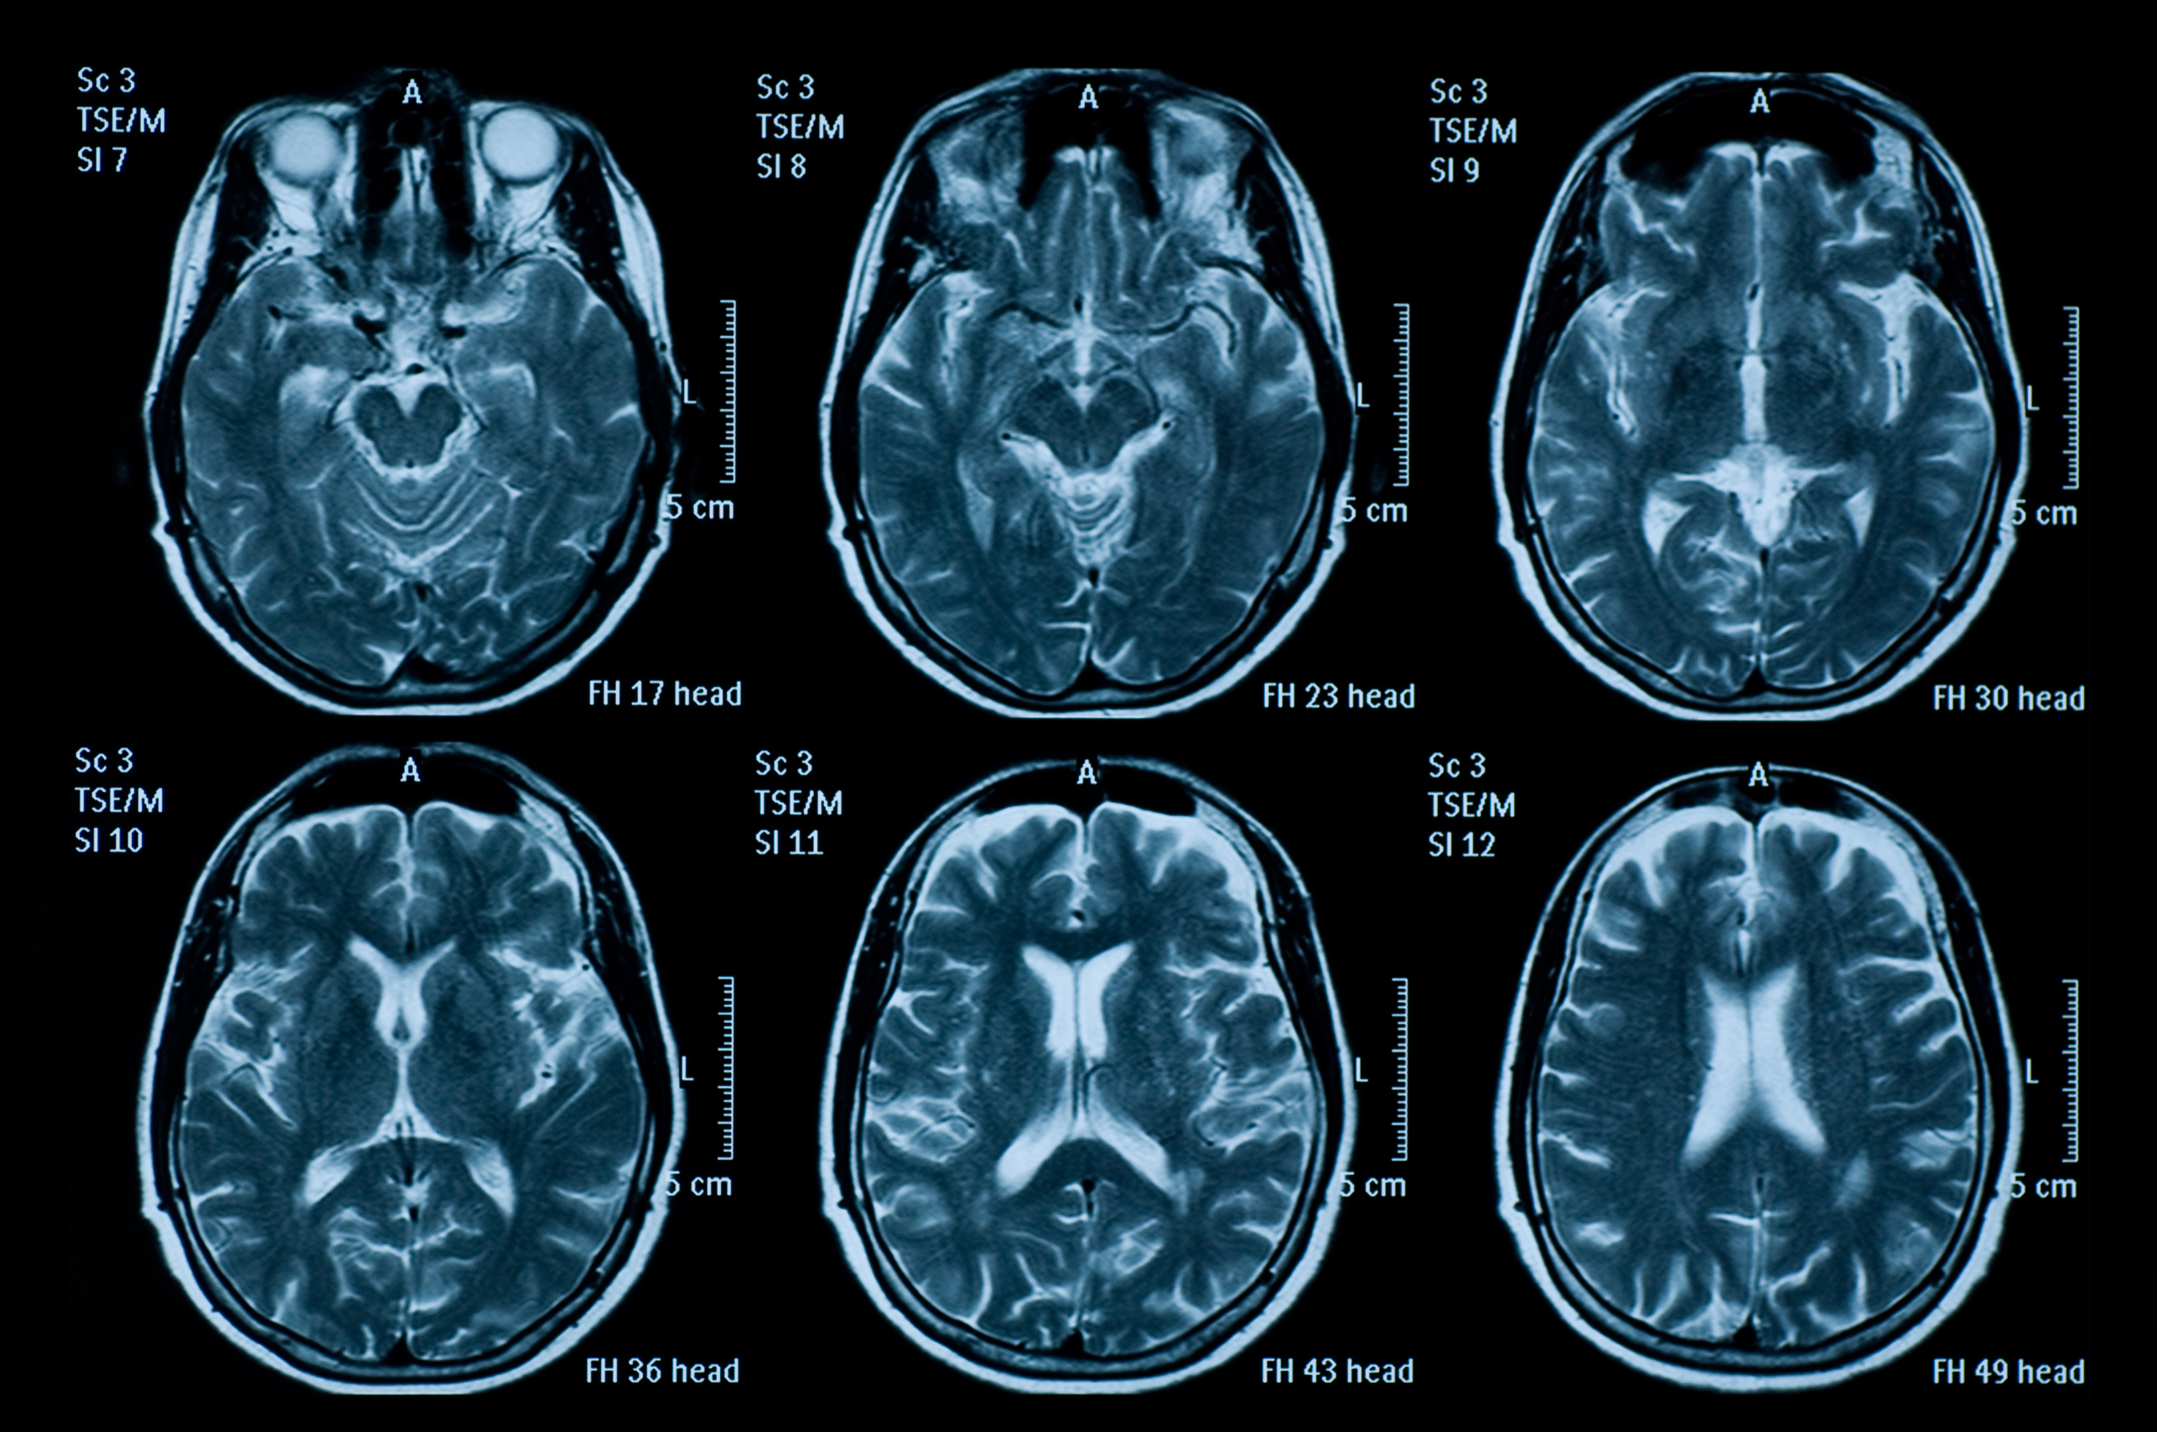

Brain Tumor Classification
Springboad Data Science Capstone
Naomi Lopez
GET STARTED

Slide 2
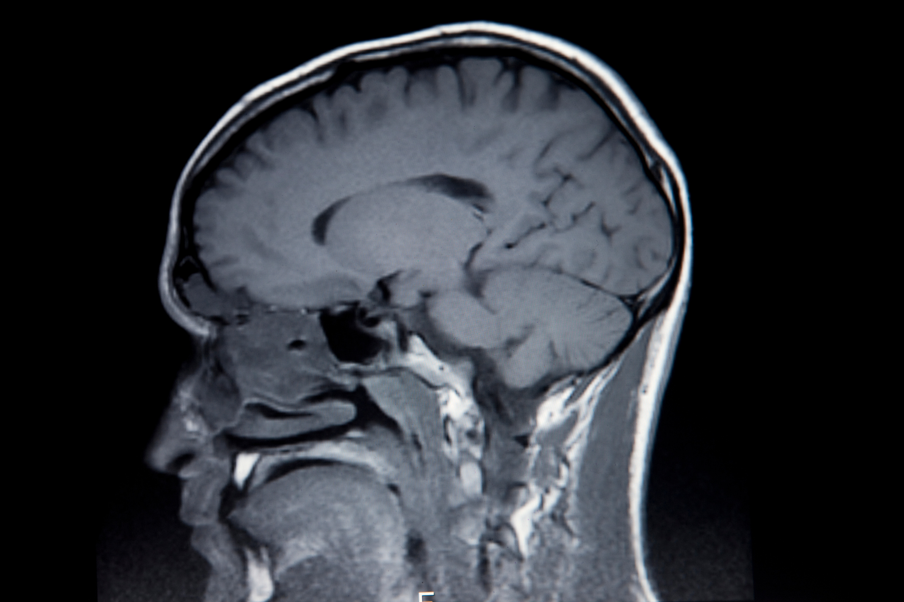

Objective
Create CNN model to classify MRI images into four categories:
Glioma
Meningioma
Pituitary
No tumor (absence of a tumor)
Approach
Techniques:
Advanced image processing
Deep learning methods
Model Capabilities:
Image classification

Slide 3
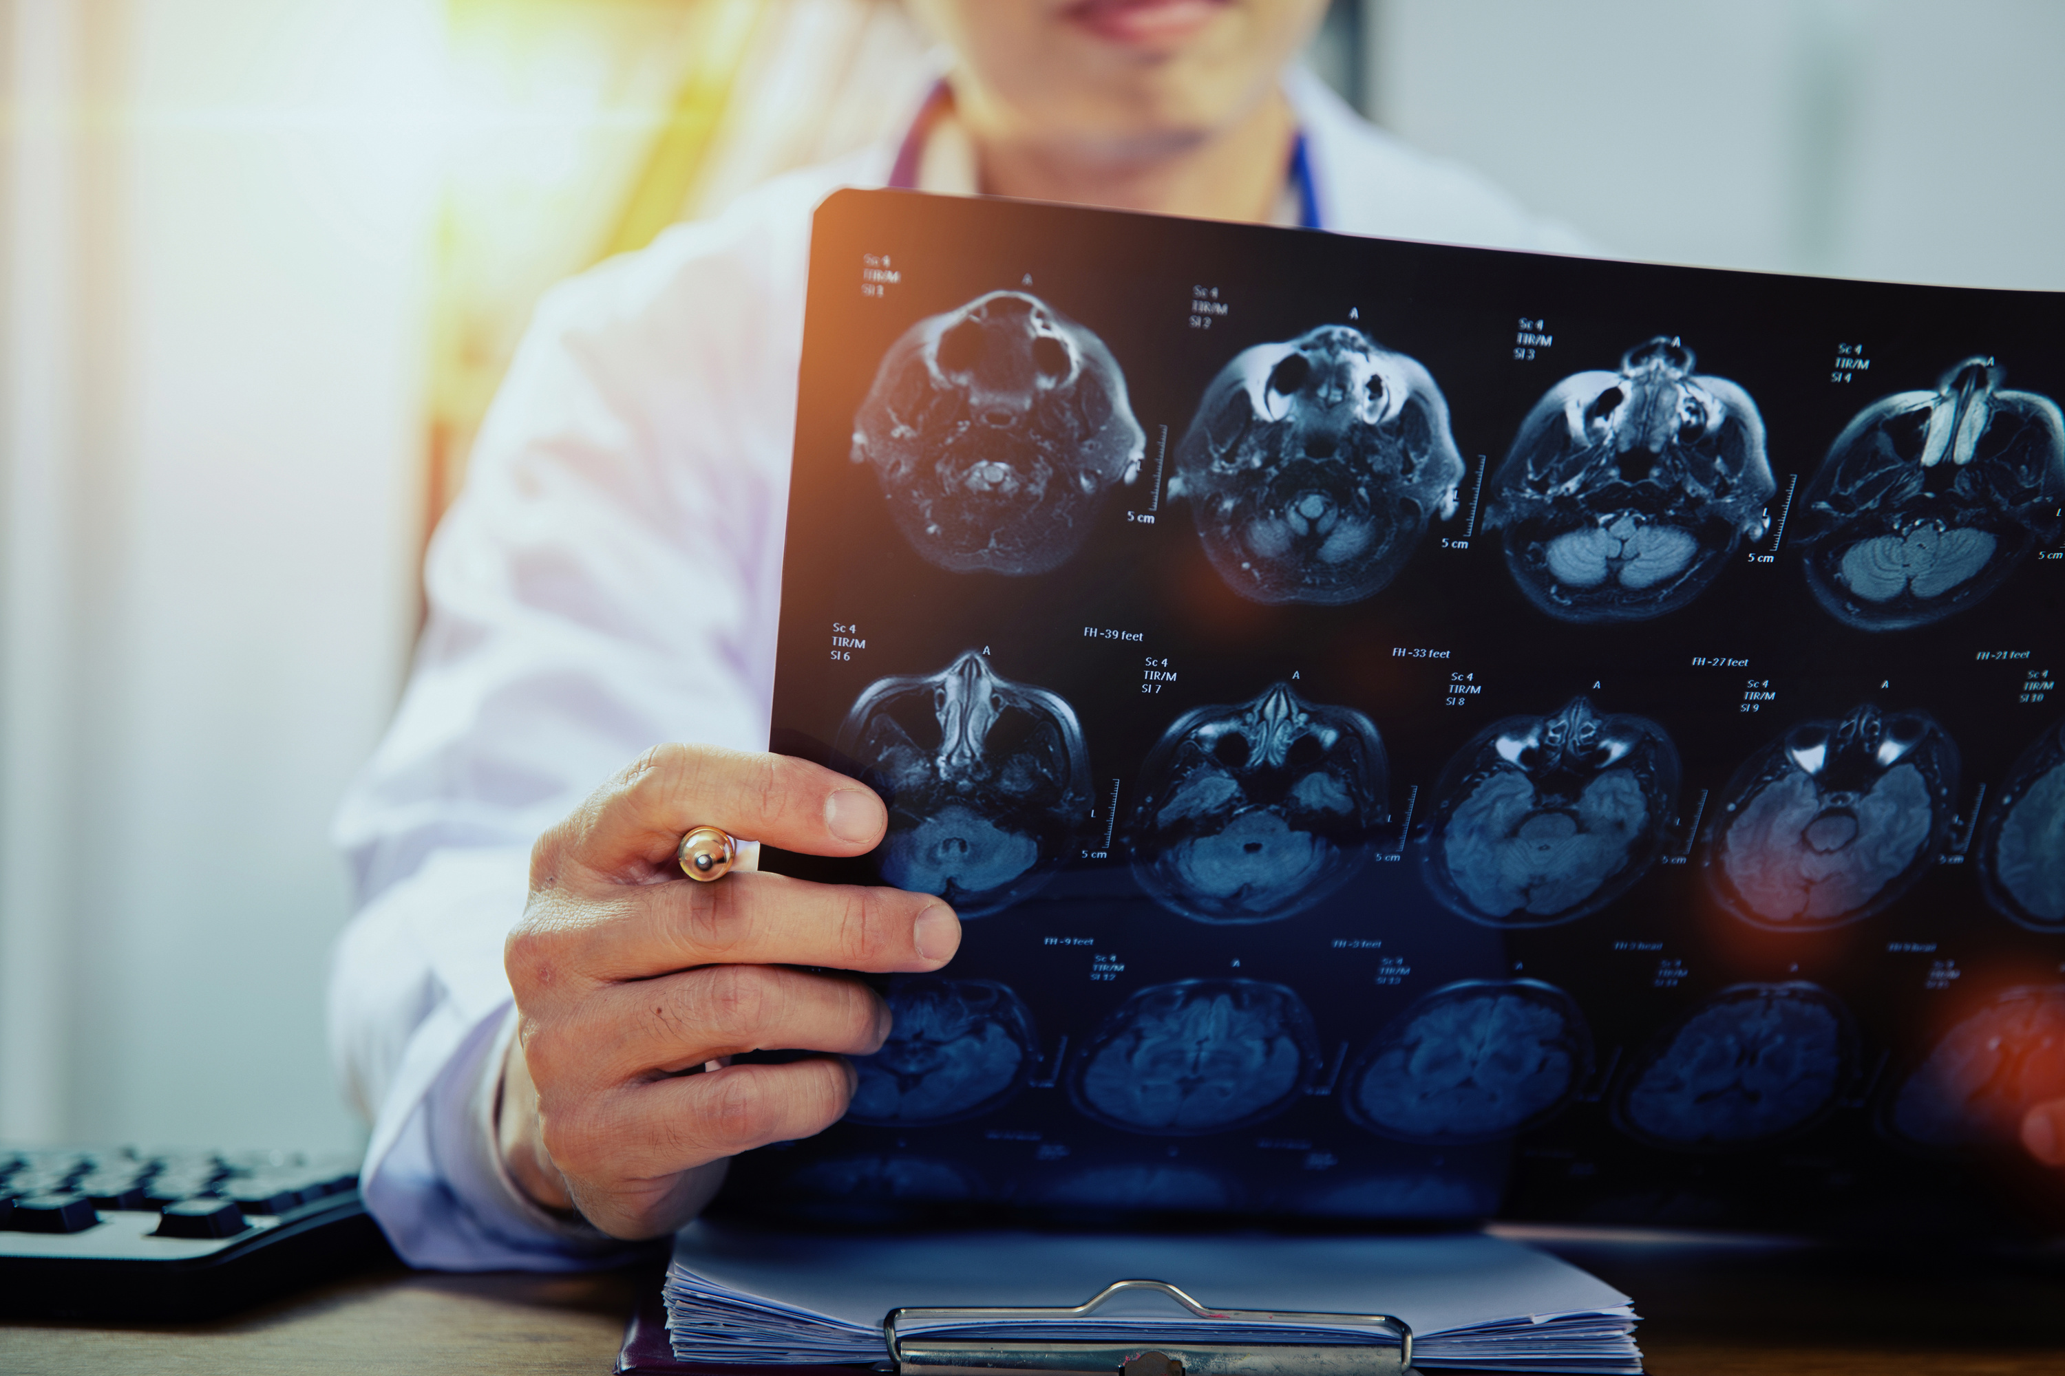
Background
Health Impact
Brain tumors significantly affect health and quality of life.
Importance of Early Detection: Critical for effective treatment planning.
Stakeholders
Radiologists
Medical professionals
Biotechnology companies

Slide 4
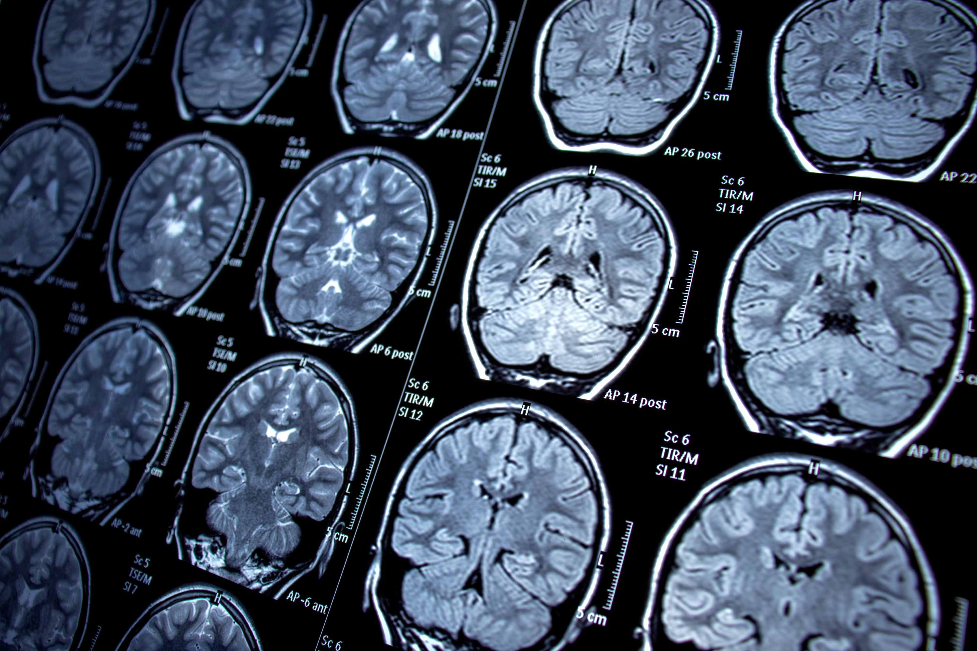
Data Overview
Data Composition
5,249 MRI images of brain tumors
Divided into training and validation sets
Four Classes of MRI Brain Tumors
Glioma:
Meningioma:
Pituitary
No Tumor (Absence of Tumor
Image Characteristics
Sagittal
Transverse
Coronal

Slide 5
Importing Data
Load Data into empty lists ensuring each image has a paired label
Image is not imported if:
Lacks corresponding label
Incorrect format
Corrupted
Total Uploaded
3670 Training Images
509 Validation (testing) Images

Slide 6
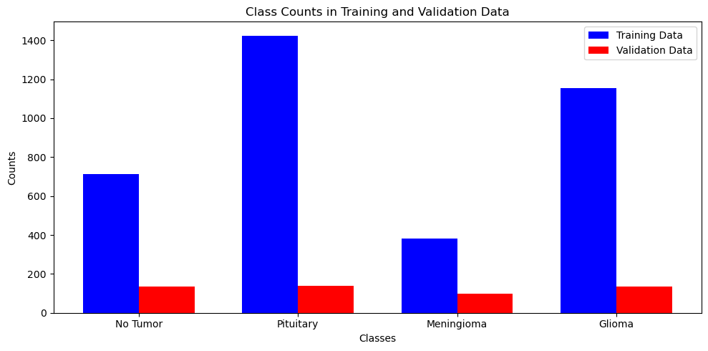
Exploratory Data Analysis
IMBALANCED TRAINING SET
Model would be subjected to overfitting without addressing imbalance
Can be balanced by weighted calsses
Validation set is well balanced

Slide 7
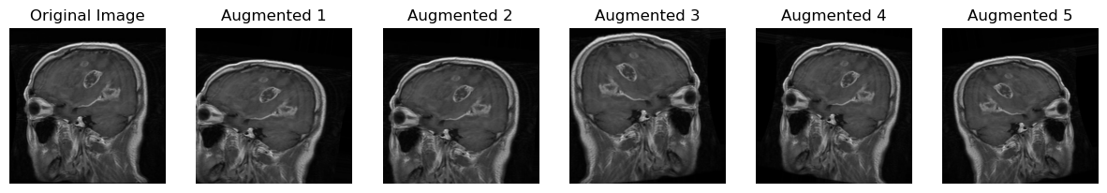
Image Augmentation
Rotating, shifting, shearing, zooming, and flipping, are applied to the original image
Expands dataset by creating diverse variations of the same input
All images resized to 224 x 224 pixels

Slide 8
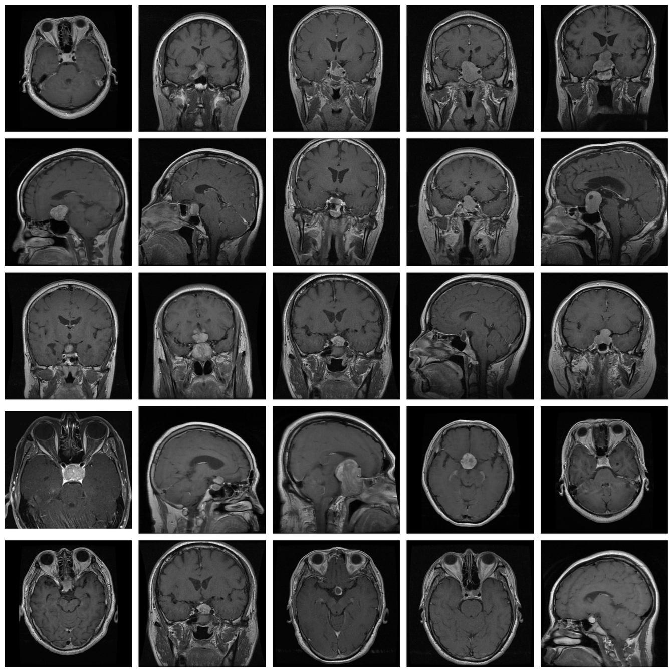
Preprocessing
NORMALIZATION
Images converted to NumPy arrays and scaled to have pixel values in the range [0, 1] by dividing by 255
Ensures that the input data is consistent and easier for the neural network to process
IMAGE GENERATOR
ImageGenerator which generated batches of data for training and validation
CLASS WEIGHTS
Convert categorical labels into a suitable format for multi-class classification

Slide 9

Model
Convolutional Neural Network
MobileNet's pre-trained base
Layers:
Flatten Layer: Converted 2D feature maps to a 1D vector.
Dense Layer: Added 128 neurons with ReLU activation to enhance learning.
Dropout Layer: Prevented overfitting by randomly deactivating neurons during training.
Output Layer: Softmax activation for multi-class classification.
Compilation: Adam optimizer with a learning rate of 1e-4 and categorical cross-entropy loss.
Callbacks:
ModelCheckpoint: Saved the best model based on validation loss.
EarlyStopping: Stopped training after four epochs without improvement.
Training: 10 epochs intended using training and validation data generator

Slide 10
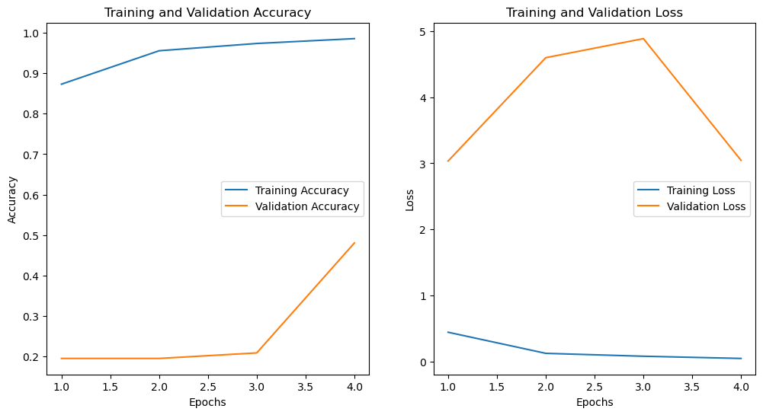
Model Performance
High Training Accuracy: Reached 98.30% by Epoch 4.
Low Validation Accuracy: Stuck around 19.53%–48.05%.
High Validation Loss: Remained above 3.0, indicating poor generalization.
Overfitting: Large gap between training and validation accuracy.
Early Stopping: Training halted at Epoch 4 to prevent overfitting.
Prediction Issue: Model predicted class 2 for all validation images.

Slide 11
Conclusion
Overfitting: Model achieved high training accuracy (98.3%) but struggled to generalize with low validation accuracy (19.5%–48.1%)
Data Complexity: Different imaging planes (sagittal, transverse, coronal) may have added complexity, limiting generalization.
Class Imbalance: Model's tendency to predict the majority class likely impacted performance.
Next Steps: Focus on data augmentation, hyperparameter tuning, and exploring alternative architectures (e.g., VGG16) to reduce overfitting.

Slide 12
Thank You

